Slide 1
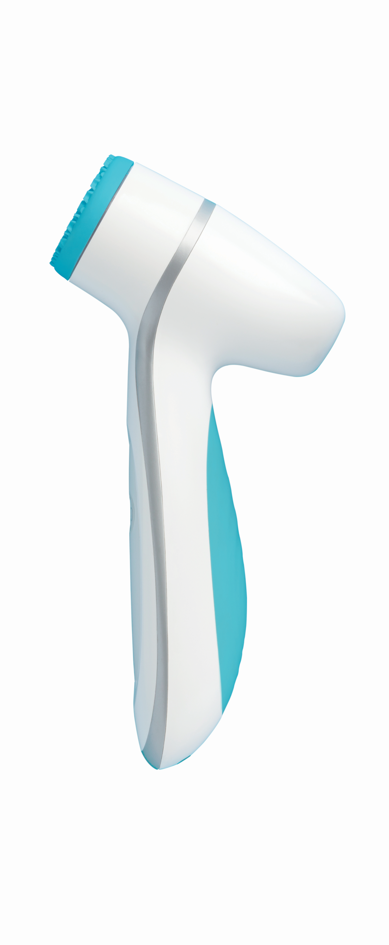

ageLOC LumiSpa
&
DO’s
DON’TS

Slide 2

CHARGING

Slide 3


ageLOC LumiSpa charging
Don’t allow your ageLOC LumiSpa device to run completely out of power. Avoid storing it for long periods without usage
Do charge your device whenever you see an amber light appear at the bottom third of the handset

Slide 4

ageLOC LumiSpa charging
Don’t charge your ageLOC LumiSpa with a non-ageLOC LumiSpa charger
Do charge your device only with the charging base and cable that is provided with your ageLOC LumiSpa

Slide 5
ageLOC LumiSpa charging
Don’t put your ageLOC LumiSpa on the charging base when the device and/or the Silicone Head is wet
Do ensure your ageLOC LumiSpa and the Silicone Head are COMPLETELY DRY before putting them on the charging base
Don’t handle the charging base with wet hands
Do make sure that your hands are completely dry when handling the charging base

Slide 6
ageLOC LumiSpa charging
Don’t place the charging base and cable close to where they can fall into water. The charging base and cable are NOT waterproof
Don’t use your charging base or cable if they accidently become wet
Do keep your charging base and cable in a dry place. Charge your device away from wet areas
After rinsing, do wipe your device and the Silicone Head or leave them to dry before placing them back on the base
Don’t put your ageLOC LumiSpa device on the charging base while it is wet

Slide 7
ageLOC LumiSpa charging
Don’t charge your ageLOC LumiSpa for short periods of time
Do charge your ageLOC LumiSpa for 12 hours. If charged as recommended, the fully charged device should function for 7 to 10 days
Don’t leave your ageLOC LumiSpa charging on the charging base longer than the recommended charging time
Do unplug the charger after charging is completed
Do charge your ageLOC LumiSpa only when it is necessary
Notes:
unplug the charger after charging period

Slide 8
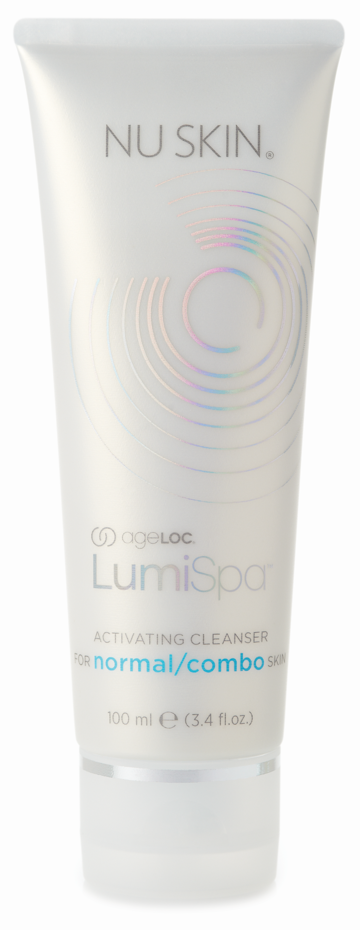
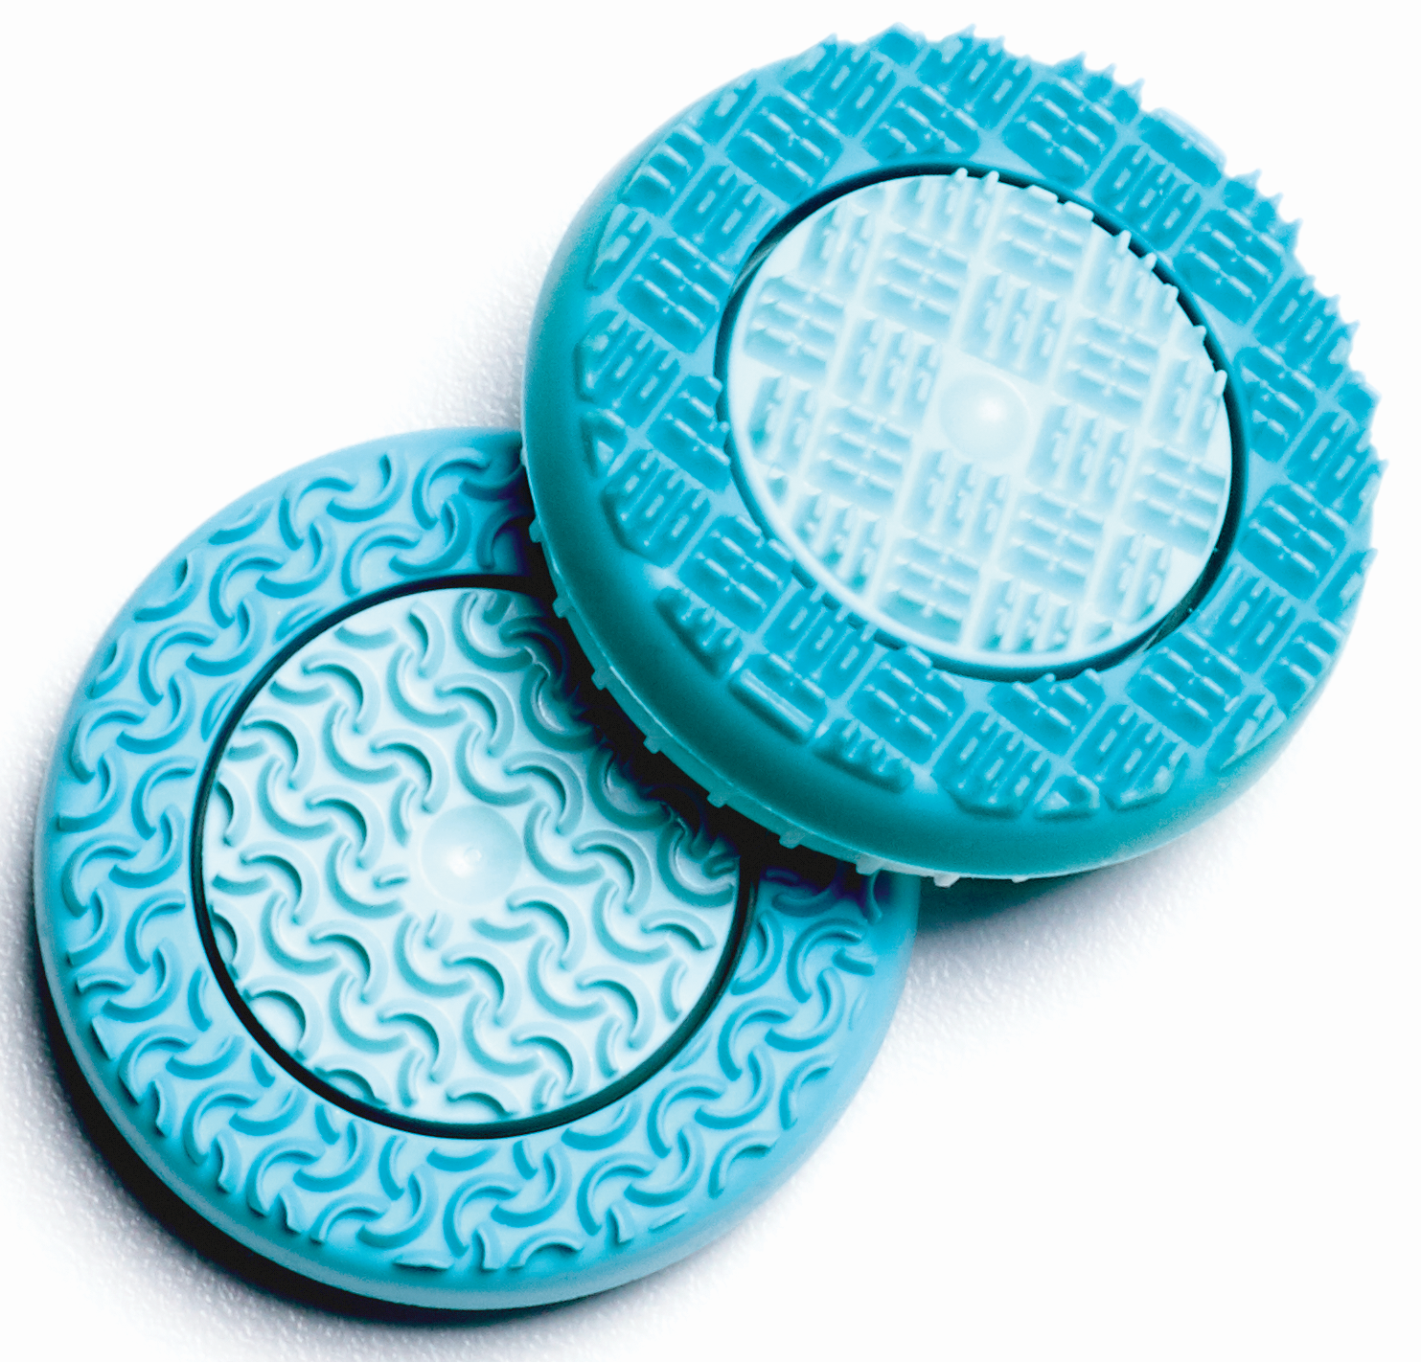
Usage

Slide 9
ageLOC LumiSpa usage
(Device, Silicone Head, Activating Cleanser)
Don’t use a Silicone Head when it is damaged
Do change the Silicone Head every 3 months

Slide 10
ageLOC LumiSpa usage
(Device, Silicone Head, Activating Cleanser)
Don’t use another cleanser than ageLOC LumiSpa Activating Cleansers with the device
To experience the 7 ageLOC LumiSpa skin benefits, do only use the ageLOC LumiSpa device with the ageLOC LumiSpa Activating Cleansers
Don’t use essential oils with ageLOC LumiSpa. Essential oils damage the silicone
Do know that only ageLOC LumiSpa Activating Cleansers provide the right viscosity that the Silicone Heads need to glide on the skin in a gentle way

Slide 11
ageLOC LumiSpa usage
(Device, Silicone Head, Activating Cleanser)
Don’t put the cleanser on the Silicone Head
Before turning on and using your ageLOC LumiSpa device, do make sure you first wet the Silicone Head and your face. The ageLOC Activating Cleanser must only be applied onto the face

Slide 12
ageLOC LumiSpa usage
(Device, Silicone Head, Activating Cleanser)
Don’t press the device too firmly onto your face while cleansing and/or scrub your face aggressively
Do glide the device across your face using slow, broad strokes

Slide 13
ageLOC LumiSpa usage
(Device, Silicone Head, Activating Cleanser)
Don’t forget to clean the Silicone Head after the skin cleansing session is over
Do remove the Silicone Head from device and rinse it with water to remove residual cleanser
Don’t forget to leave the device and the Silicone Head to dry after usage
Do rinse/clean the head holder area of the device
Do wipe the device and the Silicone Head or leave them to dry after rinsing

Slide 15
